Slide 1
JavaScript
special features
PHP web development 2019/2020
Milena Tomova
Vratsa Software
https://vratsasoftware.com/

Slide 2
Table of Contents
ES6
arrow functions
default parameter values
Array.find()
Array.findIndex()
browsers` suuport
use strict

Slide 3
ES6
arrow functions

Slide 4
ES6 arrow functions
ES6
Arrow functions allows a short syntax for writing function expressions.
You don't need the
function keyword,
the return keyword,
and the curly brackets.

Slide 5
ES6 arrow functions
ES5
var x = function(x, y) {
return x * y;
}
x(5,2)//10
ES6
const x = (x, y) => x * y;
x(5,2)//10

Slide 6
ES6 arrow functions - 2
ES5
var x = function(x, y) {
//some complicated multiline code concerning x and y
return x * y;
}
x(5,2)//10
ES6
var x = (x, y) => {
//some complicated multiline code concerning x and y
return x * y;
}
x(5,2)//10

Slide 7
ES6
default parameter values

Slide 8
ES6 default parameter values
ES6
ES6 allows function parameters to have default values.

Slide 9
ES6 default parameter values
ES6
var x = function(x, y = 6 ) {
return x * y;
}
x(5)//30

Slide 10
ES6
Array.findIndex()

Slide 11
ES6 Array.findIndex()
The findIndex() method returns the index of the first array element that passes a test function.
var numbers = [4, 9, 16, 25, 29];
var first = numbers.findIndex(myFunction);//3
function myFunction(value, index, array) {
return value > 18;
}

Slide 12
ES6
Array.find()

Slide 13
ES6 Array.find()
The find() method returns the value of the first array element that passes a test function.
var numbers = [4, 9, 16, 25, 29];
var first = numbers.find(myFunction);//25
function myFunction(value, index, array) {
return value > 18;
}

Slide 14
ES6
browsers` support

Slide 15
ES6 browsers` support
Always check browsers` support!
ES6 browsers` support

Slide 16
use strict

Slide 17
use strict
The "use strict" directive was new in ECMAScript version 5.
The purpose of "use strict" is to indicate that the code should be executed in "strict mode".
With strict mode, you can not, for example, use undeclared variables.
All modern browsers support "use strict" except Internet Explorer 9 and lower:

Slide 18
use strict
Strict mode is declared by adding "use strict"; to the beginning of a script or a function.
"use strict";
x = 3.14; // This will cause an error because x is not
declared

Slide 19
use strict
Strict mode is declared by adding "use strict"; to the beginning of a script or a function.
"use strict";
myFunction();
function myFunction() {
y = 3.14; // This will also cause an error because y is not declared
}

Slide 20
use strict
Declared inside a function, it has local scope (only the code inside the function is in strict mode):
x = 3.14; // This will not cause an error.
myFunction();
function myFunction() {
"use strict";
y = 3.14; // This will cause an error
}

Slide 21
Why “use strict”?
Strict mode makes it easier to write "secure" JavaScript.
Strict mode changes previously accepted "bad syntax" into real errors.
As an example, in normal JavaScript, mistyping a variable name creates a new global variable. In strict mode, this will throw an error, making it impossible to accidentally create a global variable.
In normal JavaScript, a developer will not receive any error feedback assigning values to non-writable properties.
In strict mode, any assignment to a non-writable property, a getter-only property, a non-existing property, a non-existing variable, or a non-existing object, will throw an error.

Slide 22
use strict
Deleting a variable (or object) is not allowed.
"use strict";
var x = 3.14;
delete x; // This will cause an error

Slide 23
use strict
Deleting a function is not allowed.
"use strict";
function x(p1, p2) {};
delete x; // This will cause an error

Slide 24
use strict
Duplicating a parameter name is not allowed:
"use strict";
function x(p1, p1) {}; // This will cause an error
more info

Slide 25
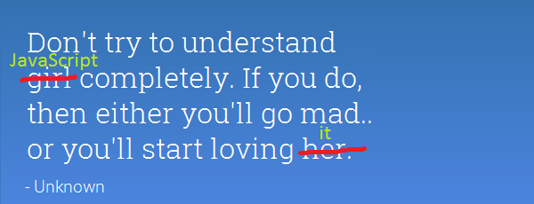
Projects

Slide 26
Development Tools

Slide 27
What can/not/ JavaScript Do?

Slide 28
What can/not/ JavaScript Do?
JavaScript
JavaScript is a scripting language that is run by the JavaScript engine of a web browser and controls the operation of the browser.
Can control DOM events
Can traverse and create HTML elements
Can modify DOM tree
Can access and/or modify browser`s cookies
Can perform asynchronous request, best known as AJAX

Slide 29
JavaScript in time

Slide 30
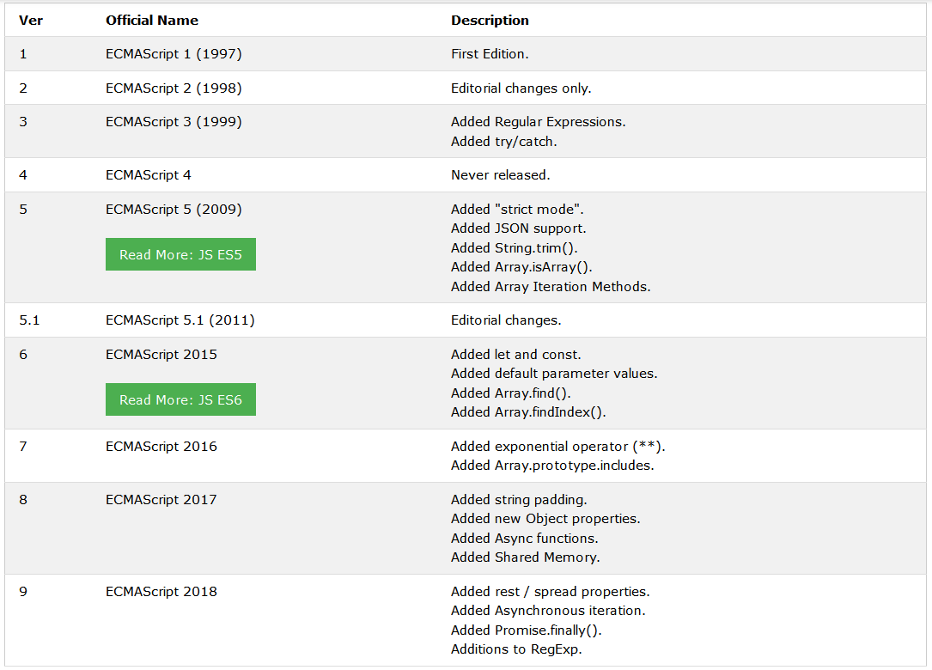
JavaScript in time
JavaScript

Slide 31
How to add JS to your projects?

Slide 32
How to add JS to ….
<body>
<script type="text/javascript">
alert('Hello JavaScript!');
</script>
</body>

Slide 33
Saving uploaded file
Script in the head element
<script type="text/javascript">
//js script goes here;
</script>
External files linked in the head element
<script src="path/to/your/js/file/here" type="text/javascript"></script>

Slide 34
Saving uploaded file
Script in the body element
<script type="text/javascript">
//js script goes here;
</script>
External files linked before the closing body tag
<script src="path/to/your/js/file/here" type="text/javascript"></script>
</body>

Slide 35
JS syntax

Slide 36
Remember
Variables and function names are Case-sensitive
Every declaration should end with ;
Whitespace/tab is ignored
JS code can be carried over to a new line for better readability under certain conditions. / JS will try to add ; if he considers that they are missing☺ /

Slide 37
Remember
Basic rules for naming variables
Can contain letters, numbers, _, $ / don't confuse it with $ in PHP /
Cannot start with a number
Variable names are case-sensitive.
There is no limit to the number of characters
but still DO NOT name them this way - theManOfTheGameThatPlayedTheDayBeforeYesterday! :))
There are special words in JS that cannot be used as variable names - new, this, etc.

Slide 38
Remember
Basic rules for naming variables
6. More popular for JS is the camel casing (taxRate)
if you use underscore for word separation -
be consistent in your code
do not mixed both

Slide 39
Remember
Basic rules - comments
/* Block comments */
//Single-line comments
//Single-line comments
//Single-line comments

Slide 40
Remember
Everything in JavaScript is a predefined object
Every string is a JS object
Every number is a JS object
Every array is a JS object
Every object is a JS object
Every JS object comes with a predefined behaviour - a set of methods/functions and properties that can be used to write JS programs.

Slide 41
Remember
Everything in JavaScript is a predefined object
Often will get an error that says … is not a function ...
If you`ve written the function correctly /no syntax mistake/ that will definitely mean that you are trying to use a function that do not belong to the type of object you have - a function that belongs to a string object and not to a number object for example!

Slide 42
Syntax
Window is a global JavaScript object, that refers to browser window
alert is window`s method
window.alert( "This is a test of the alert method " ) ;
Notice You can omit window, because it is a global object, when calling its alert method
alert( "This is a test of the alert method " ) ;

Slide 43
Remember
How to call JS object method
window.alert()
How to use JS object property
alert(window.location)
will print the URL of the current open page
location is a window property

Slide 44
JS variables

Slide 45
JS variables
After decarning the variable, its subsequent use is without var!
var subtotal; // declares one variable
var investment, interestRate, years; // declares three variables
Declaring a variable and setting a value
var subtotal = 74.00, salesTax;
salesTax = subtotal *.1; //subtotal = 74.00, salesTax = 7.4

Slide 46
JS variables
Set a value with an expression
var subtotal = 74.95; //subtotal = 74.95
subtotal += 20.00; // subtotal = 94.95

Slide 47
JS datatypes

Slide 48
Remember
Datatypes in JS
Like in PHP, we do not explicitly declare the type of data
that the variable will store.
The value we give to the variable can be of type
Integer
Fractional number - float
String
Array
Boolean
NULL

Slide 49
Remember
Datatypes in JS
Specific for JS are undefined and NaN

Slide 50
Remember
Operators in JS
The only difference from PHP is the behaviour
of + operator

Slide 51
JS syntax - operators
console.log( 1 + 1 ) //results is 2
console.log( ‘1’ + ‘1’ ) //results is 11
console.log( ‘1’ + 1 ) //results is 11

Slide 52
JS syntax - operators
Be careful when using JavaScript for calculations with a floating-point numbers
var subtotal = 74.95, salesTax; // subtotal = 74.95
salesTax = subtotal * . 1; //salesTax = 7.495000000000001

Slide 53
Remember
parselnt () & parseFloat ()
parseInt (string)
Converts a string to an integer and returns the resulting value.
If the string is not convertable to a number, returns NaN.
parseFloat (string)
Converts a string to a float and returns the resulting value.
If the string is not convertable to a float, returns NaN.
NaN = not a number

Slide 54
JS syntax - operators
Fastest way to convert a string to a number/to cast to a number is to use +
var subtotal = ‘74.95’; // string
subtotal = +subtotal + 10; //84.95

Slide 55
Remember
typeof()
typeof( var ) check the variable type

Slide 56
JS syntax - typeof( var )
var x = 5;
console.log(typeof(x)); // number
console.log(x); // 5
x = new Number(5);
console.log(typeof(x)); // object
console.log(x); // Number {}
x = null;
console.log(typeof(x)); // object
x = undefined;
console.log(typeof(x)); // undefined

Slide 57
hoisting

Slide 58
hoisting
hoisting
Hoisting is JavaScript's default behavior of moving declarations to the top.
JavaScript Declarations are Hoisted
In JavaScript, a variable can be declared after it has been used.
In other words; a variable can be used before it has been declared.

Slide 59
JS syntax - hoisting
x = 5; // Assign 5 to x
console.log(x) //5
var x; // Declare x

Slide 60
hoisting
hoisting
JavaScript Initializations are Not Hoisted
JavaScript only hoists declarations, not initializations.

Slide 61
JS syntax - hoisting
var x = 5; // Initialize x
var y = 7; // Initialize y
console.log(x);//5
console.log(y);//7
var x = 5; // Initialize x
console.log(x);//5
console.log(y);//undefined
var y = 7; // Initialize y

Slide 62
Remember
Declare Your Variables At the Top !
Hoisting is (to many developers) an unknown or overlooked behavior of JavaScript.
If a developer doesn't understand hoisting, programs may contain bugs (errors).
To avoid bugs, always declare all variables at the beginning of every scope.
Since this is how JavaScript interprets the code, it is always a good rule.

Slide 63
JS syntax - hoisting
var x = 5, y = 7; // Initialize x, y
console.log(x);//5
console.log(y);//7
var x, y; // declare x, y
x = 5; // assign value to x
y = 7; // assign value to x
console.log(x);//5
console.log(y);//7

Slide 66



Trainings @ Vratsa Software
Vratsa Software – High-Quality Education, Profession and Jobs
www.vratsasoftware.com
The Nest Coworking
www.nest.bg
Vratsa Software @ Facebook
www.fb.com/VratsaSoftware
Slack Channel
www.vso.slack.com

